Slide 1
Component-Level Design

Slide 2
Component-Level Design
the closest design activity to coding
the approach:
  review the design description for the component
  use stepwise refinement to develop algorithm
  use structured programming to implement procedural logic
  review and iterate as required

Slide 3
Stepwise Refinement
open
walk to door;
reach for knob;
open door;
repeat until door opens
turn knob clockwise;
walk through;
if knob doesn't turn, then
close door.
take key out;
find correct key;
insert in lock;
endif
pull/push door
move out of way;
end repeat

Slide 4
The Component-Level Design Model
represents the algorithm at a level of detail that can be reviewed for quality
options:
    graphical (e.g. flowchart, box diagram)
    pseudocode (e.g., PDL) ... choice of many
    programming language
    decision table
    conduct walkthrough to assess quality

Slide 5
Structured Programming for Procedural Design
uses a limited set of logical constructs:
sequence
conditional
— if-then-else, select-case
loops
— do-while, repeat until
leads to more readable, testable code
important for achieving high quality,
but not enough

Slide 6
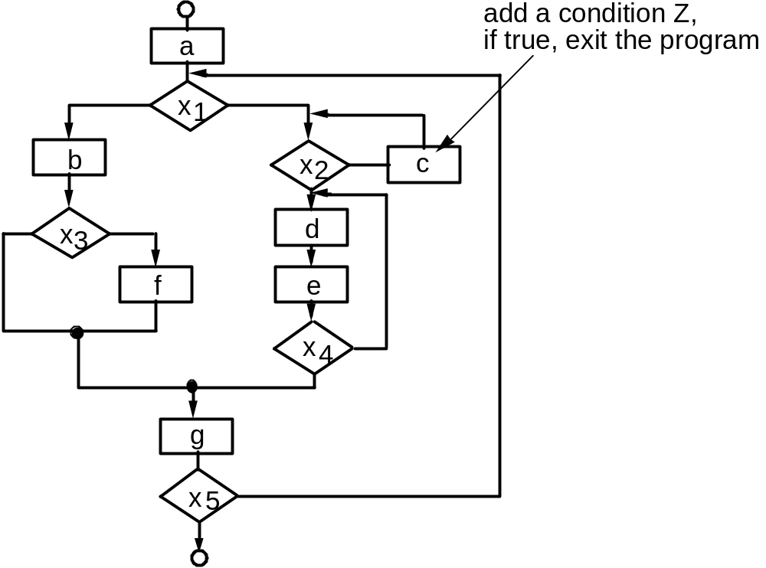
A Structured Procedural Design

Slide 7
Tabular Design Notations Using Decision Tables
DT is divided into four sections
Upper left-hand quadrant contains all conditions
Lower left-hand quadrant contains all actions
Upper Right-hand quadrant contains conditions combinations
Lower Right-hand quadrant contains corresponding actions to conditions

Slide 8
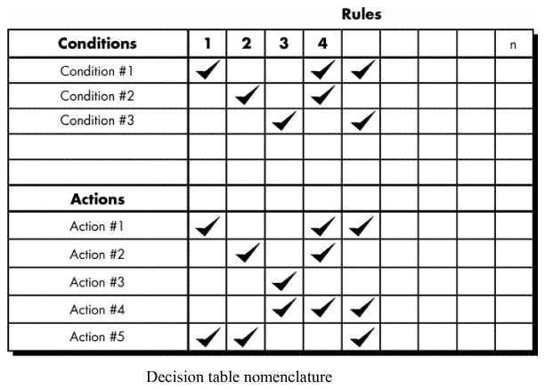

Slide 9
Example
You must decide how to dress for the weather. The conditions are that it may or may not be cloudy and it may or may not be cold. If it is cloudy, take an umbrella. If it is cold, take a coat.
Conditions | Combinations of Conditions
Cloudy | Y | Y | N | N
Cold | Y | N | Y | N
Actions | Combinations of Actions
Take umbrella | X | X |  | -
Take Coat | X |  | X | -

Slide 10
Example
Conditions | Combinations of Conditions
Important | Y | Y | N | N
Urgent | Y | N | Y | N
Actions | Combinations of Actions
Do | X
Plan |  | X
Delegate |  |  | X
Eliminate |  |  |  | X

Slide 11
Practice Example:
Conditions:
  Valid user ID
  Valid password
  Sufficient Balance
Actions
  Login accepted
  Amount transferred

Slide 12
Solution:
Conditions | Combinations of Conditions
Valid User Name | Y | Y | Y | Y | N | N | N | N
Valid ID | Y | Y | N | N | Y | Y | N | N
Sufficient Balance | Y | N | Y | N | Y | N | Y | N
Actions | Combinations of Actions
Login accepted | T | T | F | F | F | F | F | F
Amount Transferred | T | F | F | F | F | F | F | F

Slide 13
Program Design Language (PDL):
Program design language (PDL), also called structured English or pseudo code. It uses the vocabulary of one language (i.e., English) and the overall syntax of another (i.e., a structured programming language)
The difference between PDL and a real programming language lies in the use of narrative text (e.g., English) embedded directly within PDL statements.
PDL tools currently exist to translate PDL into a programming language (such as C and ADA) "skeleton" and/or a graphical representation.

Slide 14
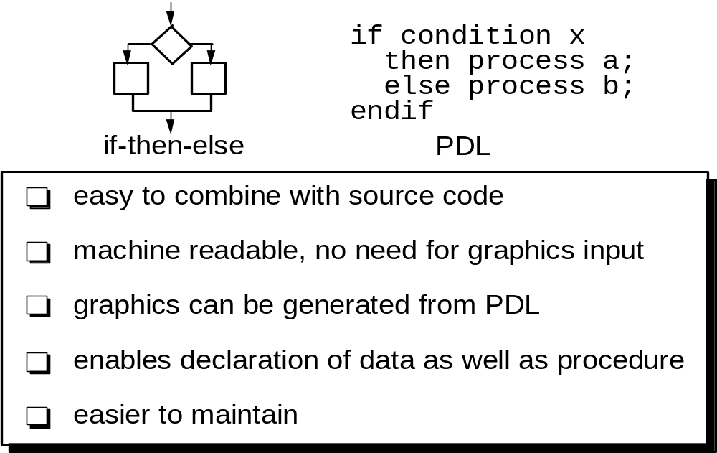

Slide 15
Why Design Language?
can be a derivative e.g., Ada PDL
machine readable and processable
can be embedded with source code,
therefore easier to maintain
can be represented in great detail, if
designer and coder are different
easy to review

Slide 16
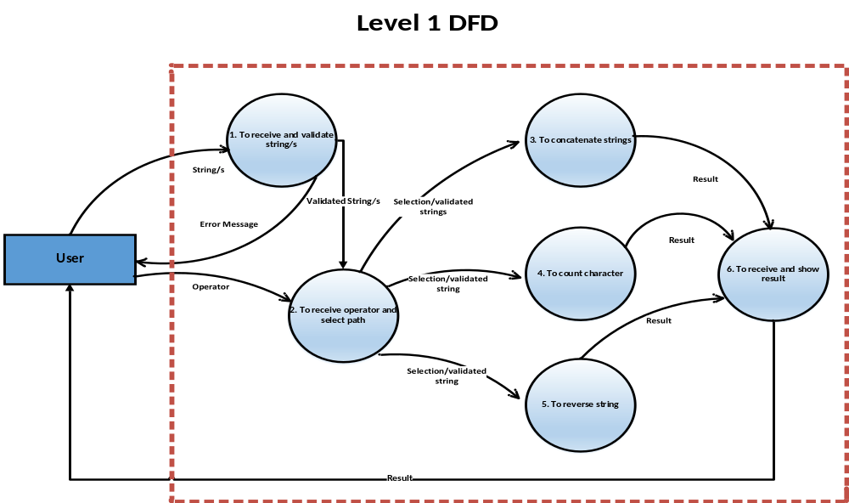
Example:

Slide 17
Char* concat(char* S1, char *S2)
{
char* newstr = new char[Len(S1) + Len(S2)];
int c=0;
for (i=0; i<Len(S1); i++)
newstr[c++] = S1[i];
newstr[c++] = ‘ ‘;
for (i=0; i<Len(S2); i++)
newstr[c++] = S2[i];
newstr[c]=‘\0’;
return newstr;
}

